Slide 1
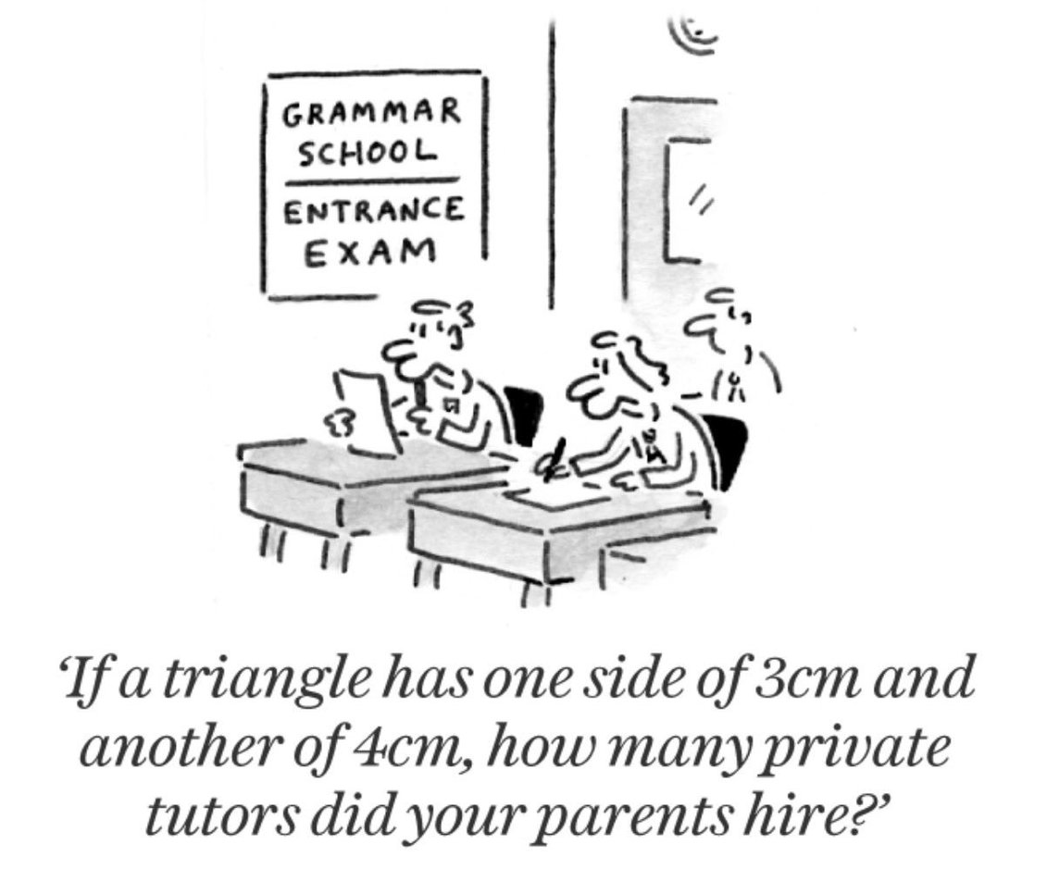
Inequality of Education

Slide 2
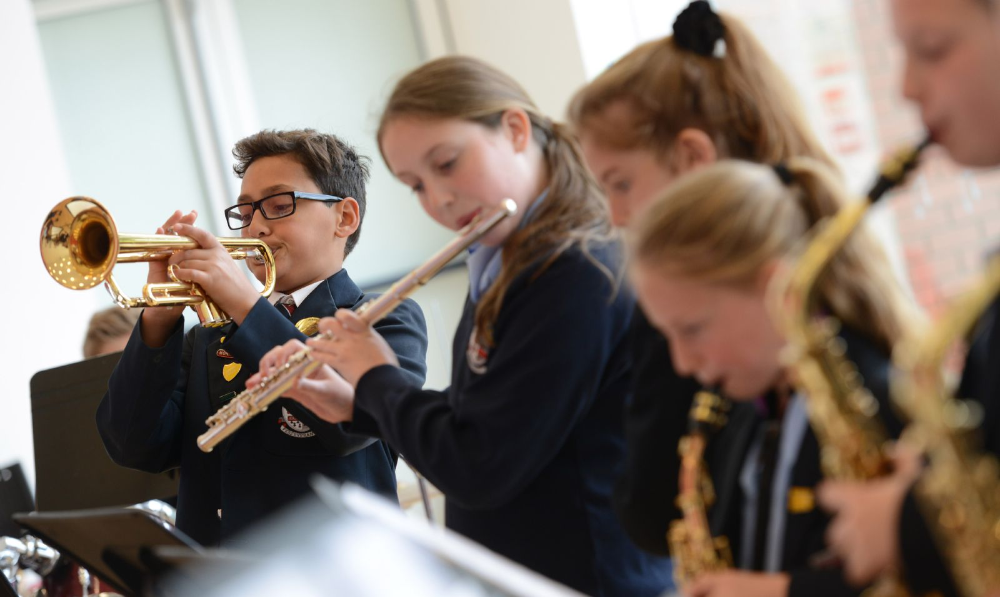
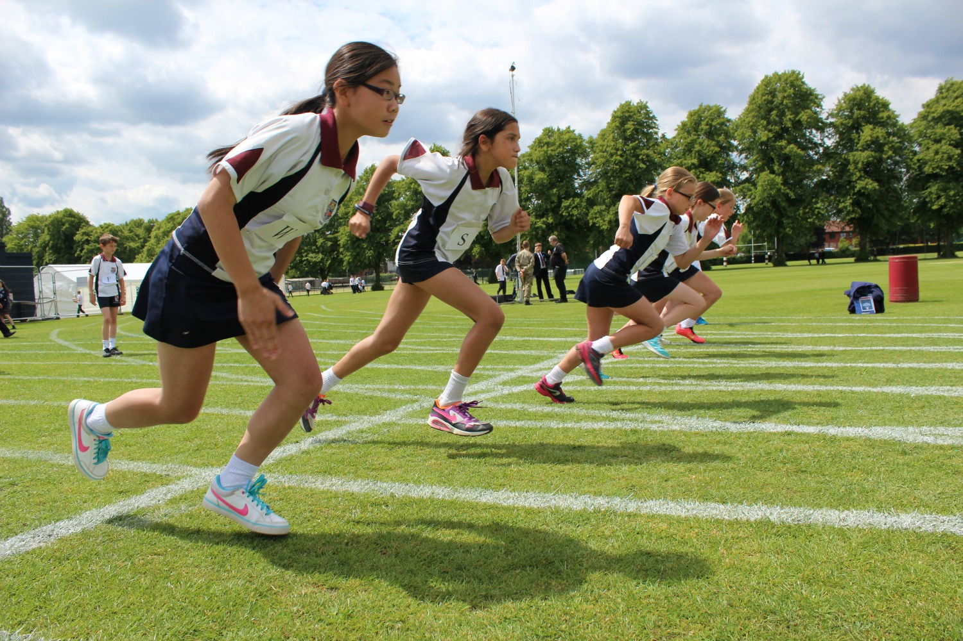
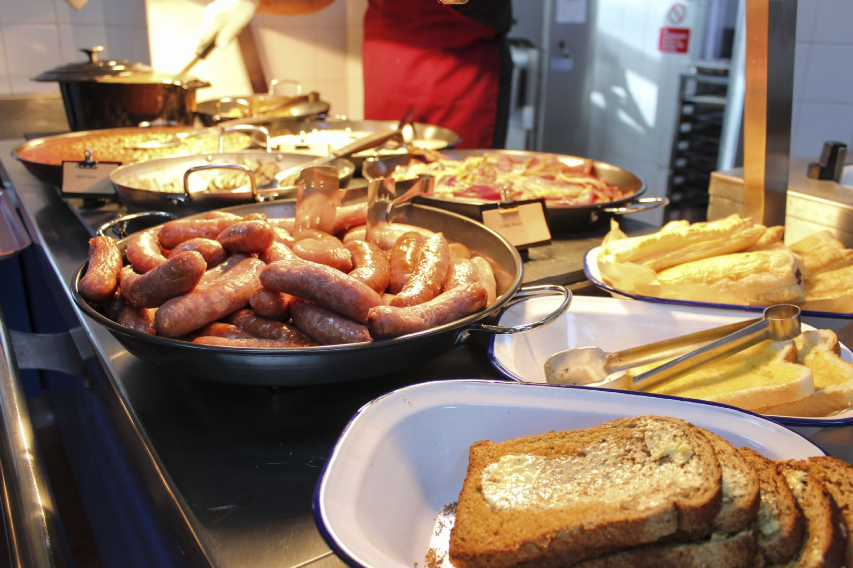
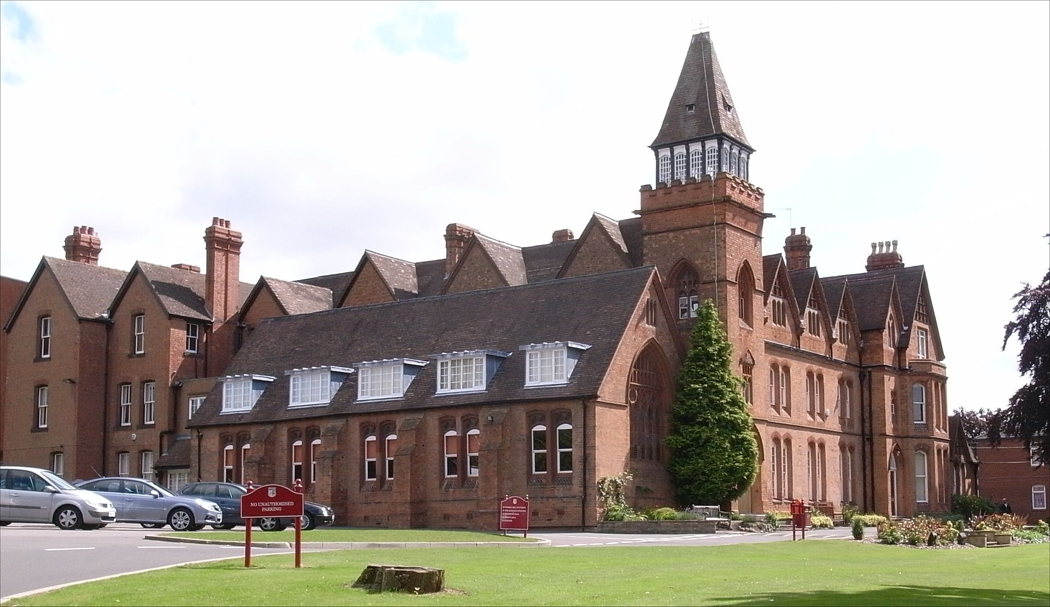
Upper-class Private schools
https://en.wikipedia.org/wiki/Solihull_School
http://www.solsch.org.uk/page/?title=Refectory+and+Food&pid=147
http://www.solsch.org.uk/page/?title=Sport&pid=17
http://www.solsch.org.uk/page/default.asp?pid=148
Quality meals
Co-curricular activities
Large & fancy campus buildings

Slide 3
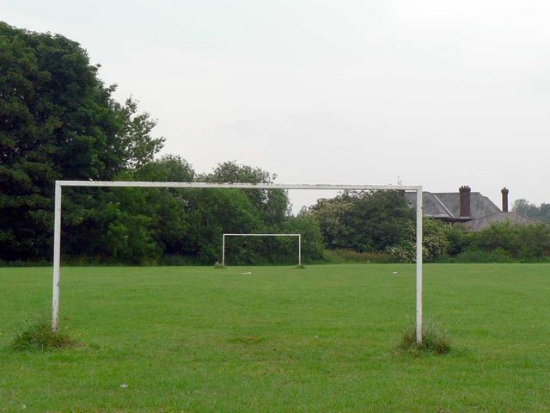
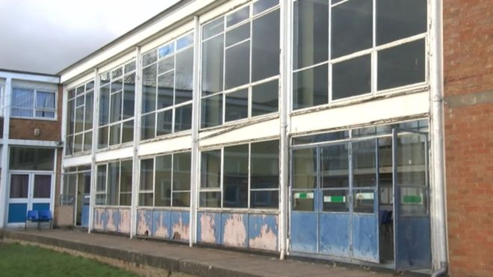
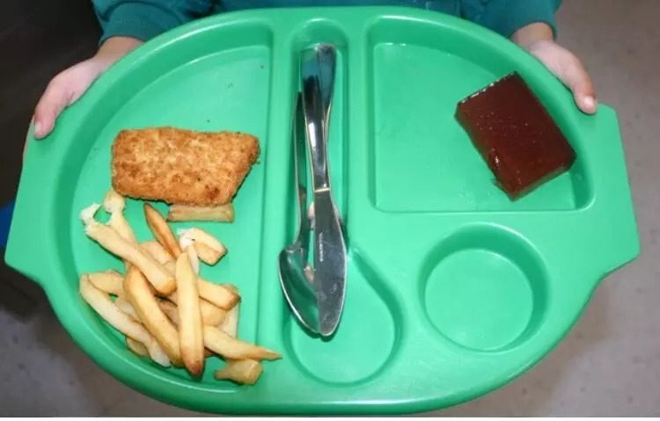
How about BAD State schools?
https://twitter.com/Jackcaplin_/status/834476135601827840
https://www.bbc.com/news/uk-wales-35581013
Fatality meals
Tiny & poor school buildings
http://www.geograph.org.uk/photo/194665
Co-curricular activities…?

Slide 4
Education Fees in the UK
£ 40,000 a year
(58,000,000 KRW)
£ 4,000 a year
(5,800,000 KRW)
State schools
Top private school
Source: The Guardian: “‘Choice’ is code for inequality – and it has polluted our education system”, Frances Ryan
(https://www.theguardian.com/commentisfree/2018/may/03/choice-inequality-education-system-social-segregation)
Source 2: “Most Expensive Boarding Schools in the UK”, Matt Hamilton
(https://thekingmaker.me/most-expensive-boarding-schools-uk/)

Slide 5


Charity status of Private schools
What is a charity?
Example of charities in the UK
Charity information: https://www.gov.uk/find-charity-information
Logos: https://www.alzheimersresearchuk.org/, http://www.aht.org.uk/

Slide 6
Charity status of Private schools
Private schools abusing the charity system
£ 522,000,000
£ 420,000,000
£ 398,000,000
Tax rebates
private schools receive
for the next 5 years
Non-means-tested
Scholarships & Discounts
Means-tested
Scholarships
Source: The Guardian, “Private schools 'abuse charity status' by giving discounts to richer families”, Julie Henry
(https://www.theguardian.com/education/2018/jun/03/private-schools-abuse-charity-status-by-giving-discounts-to-richer-families)

